Slide 1
KOKO Mobile App Strategy

Slide 2
Approach
Project Plan

Slide 3

Objectives
Identify the business requirements of departments/user groups
Create detailed documentation of existing mobile app landscape
Identify mobile app usage by different user groups in KOKO
Create a map of all user groups and their needs requiring an app
Identify the user pain-points in the current KOKO apps
Identify the functional gaps in KOKO mobile apps

Slide 4
Approach
Phases:
Business requirements by department/user groups
Map of the current KOKO mobile apps
Mobile apps requirements map
User pain-points in current apps
Mobile app functional gaps

Slide 5
Project Plan
PHASE | MILESTONE | DETAILS | STATUS
1 | Business requirements analysis | Identify business requirements of the different KOKO departments | NOT STARTED
2 | KOKO app landscape map | Map the existing apps in the KOKO ecosystem | NOT STARTED
3 | App requirements map | Map user needs to existing/required mobile apps | NOT STARTED
4 | App user pain-points | Identify the users pain-points when using the current apps | NOT STARTED
5 | App functional gaps | Perform Gap analysis to identify functional gaps in the current app ecosystem | NOT STARTED

Slide 6
1. Business process analysis
Business requirements analysis

Slide 7
KOKO Mobile App Landscape
App documentation

Slide 8
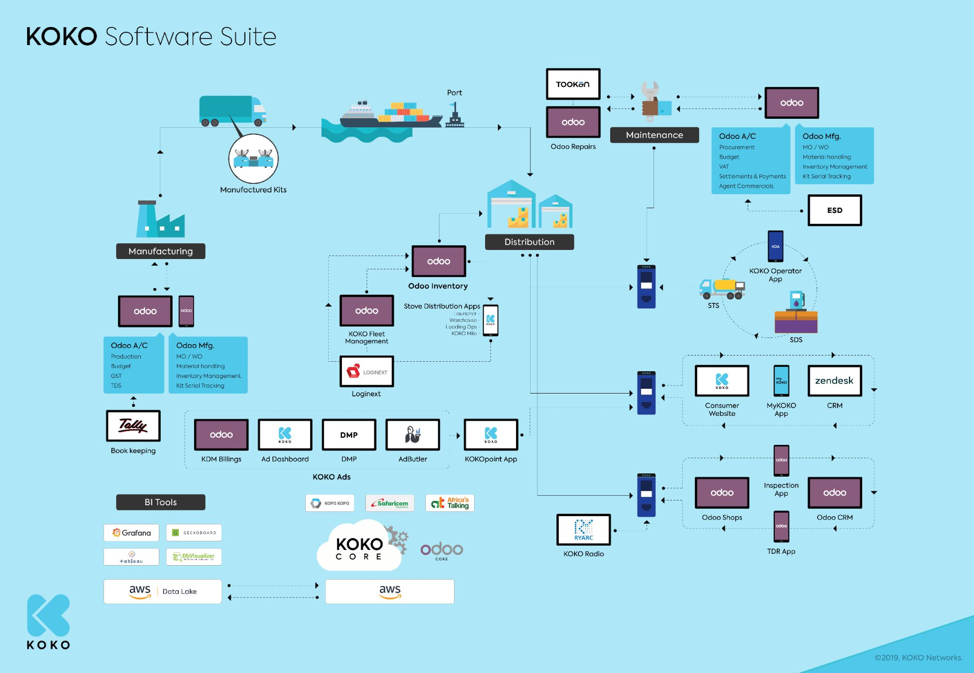
KOKO Software Landscape
Maintenance
Manufacturing
KOKO Ads
Distribution
BI Tools

Slide 9
KOKO Cooker Manufacturing
BUSINESS REQUIREMENTS | AVAILABLE SOFTWARE | MOBILE APP REQUIRED? | RECOMMENDED MOBILE APP
Production tracking | Odoo A/C
Budgeting | Odoo A/C
Goods and Services Tax (GST) | Odoo A/C
TDS | Odoo A/C
MO/WO | Odoo Mfg.
Material handling | Odoo Mfg.
Inventory management | Odoo Mfg.
Kit Serial tracking | Odoo Mfg.
Bookkeeping | Tally

Slide 10
KOKO Business Intelligence
BUSINESS REQUIREMENTS | AVAILABLE SOFTWARE | MOBILE APP REQUIRED? | RECOMMENDED MOBILE APP
Dashboarding and Data Visualization | Grafana, Geckoboard, Tableau
Data Source Connectivity | Safaricom, Africa’s Talking, Kopo Kopo
Data Management | AWS Data Lake, AWS, Odoo Core, KOKO Core
Data Querying | DbVisualizer
Data Analysis | Tableau
Reporting | Tableau

Slide 11
KOKO Fuel Business
BUSINESS REQUIREMENTS | AVAILABLE SOFTWARE | MOBILE APP REQUIRED? | RECOMMENDED MOBILE APP
Consumer website | kokofuel.com website
Consumer mobile app | myKOKO app
Customer support | Zendesk, Freshdesk

Slide 12
KOKO Network Operations
BUSINESS REQUIREMENTS | AVAILABLE SOFTWARE | MOBILE APP REQUIRED? | RECOMMENDED MOBILE APP
Production engineering support | Freshservice
Software engineering support | Zendesk, Freshdesk
After business hours support

Slide 13
KOKO Fuel Distribution
BUSINESS REQUIREMENTS | AVAILABLE SOFTWARE | MOBILE APP REQUIRED? | RECOMMENDED MOBILE APP
SDS | Operator app
STS | Operator app
KOKO Fleet management | Loginext, Odoo inventory
Stove distribution | Launcher, Warehouse, Loading ops, KOKO Mile

Slide 14
KOKO Cooker Distribution
BUSINESS REQUIREMENTS | AVAILABLE SOFTWARE | MOBILE APP REQUIRED? | RECOMMENDED MOBILE APP
Stove distribution | Launcher, Warehouse, Loading ops, KOKO Mile
Procurement | Odoo AC
Budget | Odoo AC
VAT | Odoo AC
Settlements & Payments | Odoo AC
Agent Commercials | Odoo AC
Logistics | Tookan
MO/WO | Odoo Mfg
Material handling | Odoo Mfg
Inventory management | Odoo Mfg
Kit Serial Tracking | Odoo Mfg

Slide 15
KOKO Digital Media
BUSINESS REQUIREMENTS | AVAILABLE SOFTWARE | MOBILE APP REQUIRED? | RECOMMENDED MOBILE APP
KDM Billing | Odoo
Ad zone management | Ad Dashboard
Ad targeting | DMP
Ad management | AdButler
Ad scheduling | AdButler
Ad display | KOKOpoint app
Media hosting | AWS S3

Slide 16
KOKO Radio
BUSINESS REQUIREMENTS | AVAILABLE SOFTWARE | MOBILE APP REQUIRED? | RECOMMENDED MOBILE APP
Shop (site) management | Odoo Shops
Site inspection | Inspection App
Timeout detection and recovery | TDR app
Client billing | Odoo CRM
Media hosting | Ryarc
Media scheduling | Ryarc

Slide 17
KOKO Mobile User Requirements
Identify user requirements for mobile apps in KOKO

Slide 19
Mobile App Development Strategy
Selecting A Suitable Development Strategy

Slide 20
Overview
Mobile applications are integral to nearly every organization’s business strategy. With the right strategy, mobile applications can provide increased visibility to the organization’s mission, while also helping provide value to external stakeholders. There is however a higher risk for the organization if the wrong mobile application development strategy or technology is adopted.
KOKO Networks operates in a fast-evolving environment characterized by constantly changing operating platforms with frequent updates, along with many new devices and form factors. Additionally, with multiple channels available for communicating with mobile users in terms of technology, platforms, and User Experience (UX), KOKO is faced with the dilemma of making the right choices.
A mobile app, or application, is defined as any native (downloadable) or Web application designed specifically to be accessed and utilized on a handheld mobile device e.g. smartphone, tablet etc. They can be designed as a mobile web app, hybrid app or native mobile app.

Slide 21
Planning a Mobile App
Before creating a mobile app, there’s need to think about your audience’s requirements. The following questions are pertinent:
What’s the organization’s overall strategy
Who is the intended audience (users)?
What are the users’ requirements for mobile apps?
How will the mobile app be used?
What resources will the application require, and where do I need feedback from business stakeholders?
How will success be measured (KPIs)?
What is the expected End of Life (EOL) of the mobile app?
Will a mobile website be sufficient?
Will the mobile app be data-centric, content-centric or both?
Prior to deciding the app development strategy, the type of mobile app will have to be determined. However, in order to promote code reuse and interoperability, applications should be built using a hybrid application development strategy.

Slide 22
The “One-Size Fits All” model
When trying to decide what type of Mobile Applications should be delivered to the target users, the KOKO Networks must not take a one-size fits all approach. Making this decision involves a trade-off between providing a rich, native user experience versus the portability of the application across platforms that will sacrifice the rich native UX.
There are pros and cons to adopting both paths that must be taken into consideration by the KOKO Product team, which will have to evaluate this issue based on key parameters such as native experience, cost of development, time to market, ease of deployment, and managing the apps to determine the best choice. KOKO’s Mobile Application Development Strategy will need to evaluate the following types of mobile app development and briefly outline the advantages and disadvantages against each of them:
Mobile Web App Development (Preferred)
Hybrid App Development (Preferred)
Native Mobile App Development
The following evaluation criteria must be taken into consideration when making a choice on what mobile application development strategy will be adopted by KOKO Product.
Native UX
Portability
Time to market
Maintenance & management
Ease of deployment

Slide 23
1. Mobile Web App Development (Preferred)
Mobile web apps are developed using HTML5, CSS3, and JavaScript. These application are executed on the web server, accessible via web browsers, and are portable across multiple mobile platforms. These mobile web apps are fully responsive to various screen sizes. However, a native and rich UX is impossible to create using this strategy. Despite the fact that several device specific functions and offline stores can be leveraged via HTML5, constraints exists due to the sandbox nature of specific platforms and the extent to which HTML5 specifications are adopted by native browser components on the user’s device.
Advantages | Disadvantages
Better manageability due to web server based deployments | Lack of native UX
Excellent portability across multiple platforms | Lower performance due to browser based dependencies
High ease of code maintainability and reuse | Dependence on native browser implementation for access to device capabilities
Decrease in total cost of ownership | Unpredictable performance due to dependency on internet connection
Lower development costs | Applications are “stateless” meaning that the user must initiate a task before the application will respond.
Fastest time to market

Slide 24
2. Hybrid App Development (Preferred)
Hybrid app development frameworks leverage a combination of web based and native app development. Applications are built using HTML5, CSS3 and JavaScript. These applications are then compiled using the native SDK and provide better portability across platforms as compared to native apps. Some of the hybrid frameworks provide flexibility to extend and customize the platform by adding additional wrapper plug-ins which allow the application to access more specific native device capabilities.
Advantages | Disadvantages
Limited access to native device capabilities | UX is better than mobile web applications but not as good as native mobile applications
Excellent portability across platforms | Performance issues due to browser based dependencies
Easy to deploy like native applications | Dependency on hybrid framework developer to add capability for native API extensions
Greatest potential for code reuse
Decreased ownership cost
Faster time to market

Slide 25
3. Native Mobile App Development
Native mobile apps created for a specific operating system are developed using the native language of that platform (such as Google’s Java-based “Android” or Apple’s Objective C “iOS”). The applications have access to all of the devices capabilities and functionalities since they use the native SDK for application development. These application provide the highest UX factor compared to other types of application development.
ADVANTAGES | DISADVANTAGES
Tighter integration with platform which results in the app running more efficiently. | A unique set of source code is created which prohibits code reuse
Maximum performance | Higher development and maintenance costs
Easier to deploy to app stores | Longer time to market, since app store approval is required
 | More expensive to develop and reach a smaller audience

Slide 26
Deciding Between Mobile/Hybrid/Native App Development
Along with business requirements, various factors must be taken into consideration when selecting a mobile app development approach:
What would be the application capabilities across various platforms? Will the application have similar capabilities across platforms? All platforms are not able to handle application capabilities in a similar fashion. An example would be the iOS handles user notification and application states differently than Android.
A user’s experience can differ from one platform to another. Views that may be possible on iOS may not be able to be implemented on an Android and/or Windows mobile device.
Data synchronization needs must be taken into consideration. Does the native mobile application need to connect with a server to synchronize data? What data synchronization approach will be taken across all platforms?
Will performance be compromised when implementing solution across various platforms
How will the application be distributed when available across multiple platforms?
Storage capability and method must be taken into consideration when building the application across various platforms.

Slide 27
Mobile Web and Hybrid Apps Should Be the First Choice
Mobile web apps are platform agnostic and do not require deployment directly to the device which significantly simplifies the deployment process. A web based app that leverages a responsive web template should be considered as the first option especially if the application is very simple and leverages only the common functionality of HTML5 that is supported across all browsers. Hybrid app development should be the second preference.
When developing a mobile web app consider the following key design principles:
Detect device capability and adapt the content that will be delivered.
An effective mobile layout needs to be simple. Information presented needs to be structured into a layout that minimizes horizontal and vertical scrolling and any need for zooming.
Mobile web app need to be easy to navigate while making the best use out of the device’s capabilities. Reducing the number of clicks to perform an action is critical to improve navigability of a mobile web application.
Content must be adapted based on the device.
Unnecessary text and links must be hidden when possible to make the best use of screen real estate.
Different graphics should be leveraged for different screen resolutions.
Video formats must be adapted to what is supported by the device.
Interaction mechanisms must be customized based off of the capability of the device.
Online/offline operation needs to be taken into consideration since the mobile web experience can be badly impacted based on the persistence of an internet connection. Mobile web applications should leverage local caching whenever possible.
Mobile web apps should provide faster response times while reducing data usage on mobile devices.

Slide 28
Mobile Web/Hybrid Apps Should Be First Choice
Various questions need to be addressed when deciding which of the three outline mobile app development strategies should be leveraged:
How complex and graphics intensive is the mobile app?
Does the mobile application need to be deployed on multiple platforms?
What changes can be anticipated with the mobile app and can these changes be addressed with the chosen development strategy?
Is there an immediate need to deliver the app to the market?
What is the end of life for the application being developed?
Does the mobile app need to synchronize with back end systems or pull from data sources?
How frequently will the mobile app need the upgraded and does the application storefront deployment plan support these upgrade requirements?
Considering native UX versus portability is critical in the decision making process as to which mobile application development strategy to use since this has broad implications on the application manageability, time to market and cost.

Slide 29
Suggested activities
Map the existing KOKO apps landscape
Research and document external industry references (e.g. startups and larger companies)
Understand app usage split by different user groups
Map the different user groups requiring an app including those who don’t have an app today
Map the current pain-points of the apps for different users
Map the user needs for each different stakeholder group
Identify the gaps we have today
Prioritise the different user needs
How can these different needs best be served best; what should our strategy look like
Understand the technology challenges and benefits of different options

Slide 31
Output
A clear and well structured proposed strategy and set of actionable recommendations
Documentation of existing mobile app landscape and user needs by department
Documented research on internal and external sources
Documentation of current and anticipated future user needs by stakeholder group
Proposed roadmap with logical prioritisation

